Slide 1
深度学习调参

Slide 2
一. 建立评价指标
最好是一个指标
指标是容易理解的
指标的范围最好是在[0,1]之间, 最好是线性的.
回归问题: 均方差 mse
分类问题: F1 分数(good), 准确率precision + 召回率recall (bad)
标题生成: BLEU

Slide 3
二. 建立合理的预期
深度网络可能达到的评价指标最好的值? (以image captioning为例)
Image captioning可以理解为四个串行任务:
1. 目标识别
2. 目标动作识别
3. 场景理解
4. 语言合成

Slide 4
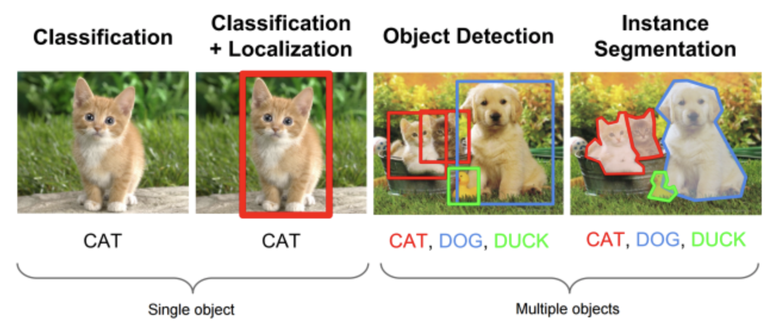
1. 目标检测

Slide 5
1. 目标检测的效果

Slide 6
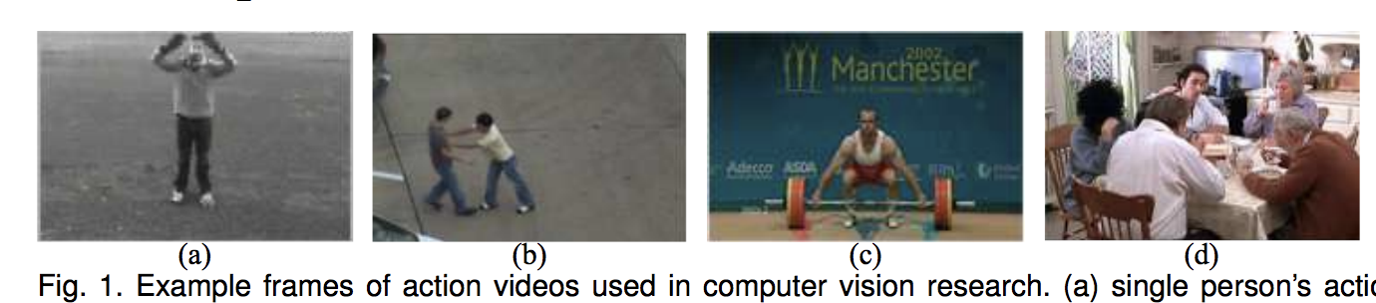
2. 动作识别
https://arxiv.org/pdf/1806.11230.pdf

Slide 7
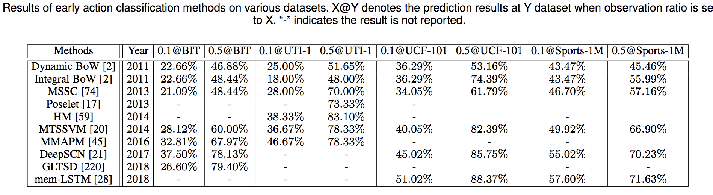
2. 动作识别效果
https://arxiv.org/pdf/1806.11230.pdf

Slide 8
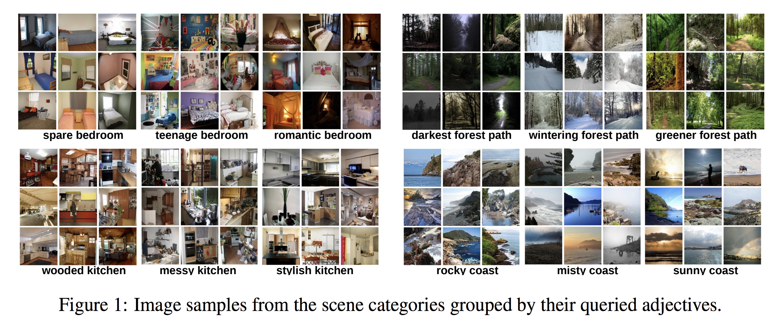
3. 场景理解
http://places.csail.mit.edu/places_NIPS14.pdf

Slide 9
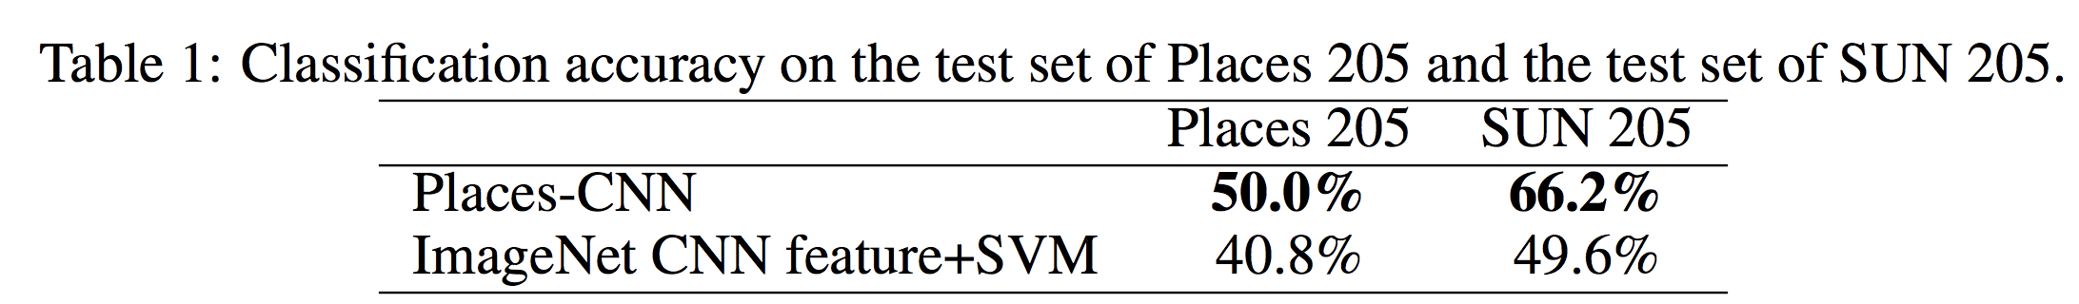
3.场景理解的效果
http://places.csail.mit.edu/places_NIPS14.pdf

Slide 10
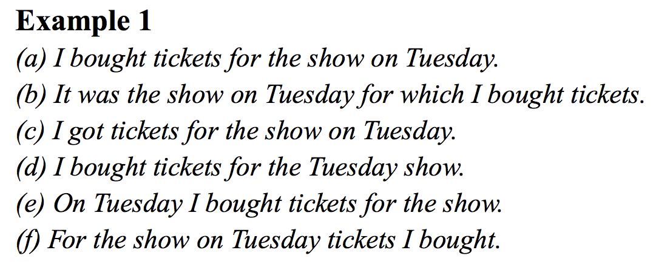
4. 文本合成

Slide 11
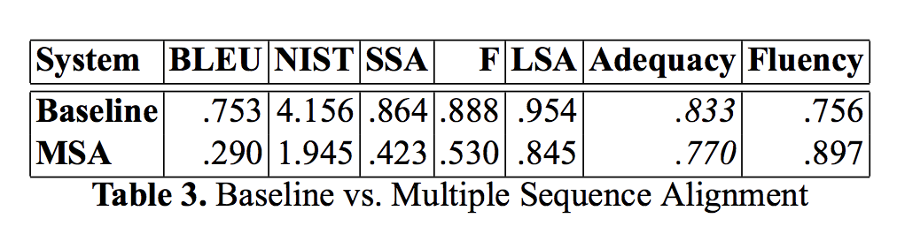
4. 文本合成的效果
http://www.cs.cmu.edu/~mrmarge/cicling04eval.pdf

Slide 12
Image Captioning 预期的最佳效果
目标检测效果 * 动作识别效果 * 场景理解效果 * 文本合成效果 =
0.36 * 0.88 * 0.66 * 0.753 = 0.16

Slide 13
三. 建立合理的数据集
测试数据集的数据 == 训练数据集的数据?
以image captioning 为例:
1. 测试图像里面的物体(人, 狗, 飞机, 篮球)和场景(打篮球, 坐飞机)是否出现在训练数据集中? 如果没有, 需要添加具有这些物体和场景的图像在训练数据集中
2. 测试图像对应的标题中的单词(飞机, 篮球, 坐飞机, 打篮球) 和句子(一群男孩在打篮球) 是否出现在训练数据集中? 如果没有, 也需要添加这些物体和场景在训练数据集中
3. 如果测试数据和训练数据的coverage(包含的图像内容, 和单词句子描述)都一致的情况下. 网络是欠拟合还是过拟合, 如果欠拟合, 应该增加网络复杂度

Slide 14
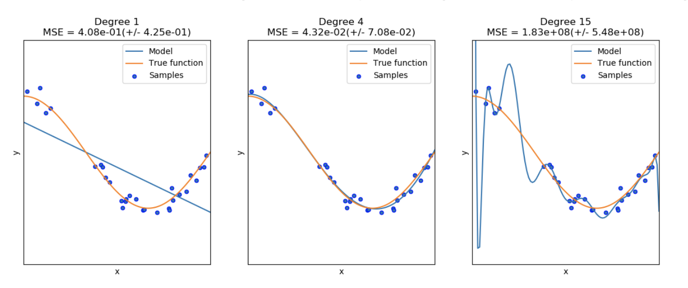
四. 判断是否欠/过拟合
f(x) = ax + b f(x) = a x^4 + b x^3 + c x^2 + dx + e f(x) = a x^15 + b x^14 + …
Underfitting (欠拟合)
Good fitting (正好拟合)
Overfitting (过拟合)

Slide 15

理解bias/variance
$$Y=f\left(X\right)+e$$

Slide 16
理解bias/variance (续)

Slide 17
Bias 和variance的平衡

Slide 18
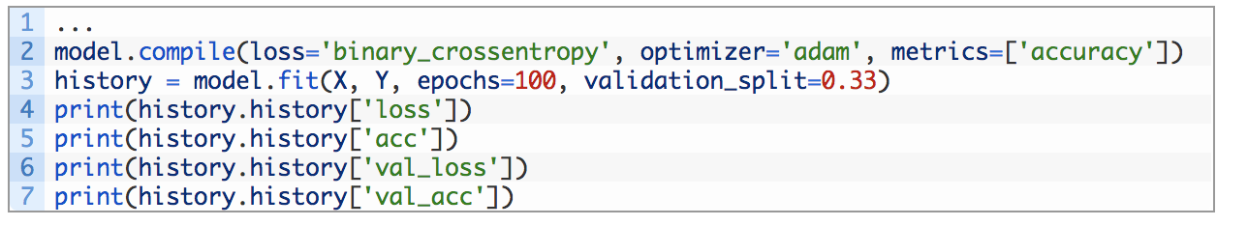
判断过/欠拟合的一般代码

Slide 19
欠拟合loss变化曲线(1)
理论上的比较好的loss

Slide 20
from keras.models import Sequential
from keras.layers import Dense
from keras.layers import LSTM
from matplotlib import pyplot
from numpy import array
# return training data
def get_train():
seq = [[0.0, 0.1], [0.1, 0.2], [0.2, 0.3], [0.3, 0.4], [0.4, 0.5]]
seq = array(seq)
X, y = seq[:, 0], seq[:, 1]
X = X.reshape((len(X), 1, 1))
return X, y
# return validation data
def get_val():
seq = [[0.5, 0.6], [0.6, 0.7], [0.7, 0.8], [0.8, 0.9], [0.9, 1.0]]
seq = array(seq)
X, y = seq[:, 0], seq[:, 1]
X = X.reshape((len(X), 1, 1))
return X, y
# define model
model = Sequential()
model.add(LSTM(10, input_shape=(1,1)))
model.add(Dense(1, activation='linear'))
# compile model
model.compile(loss='mse', optimizer='adam')
# fit model
X,y = get_train()
valX, valY = get_val()
history = model.fit(X, y, epochs=100, validation_data=(valX, valY), shuffle=False)
# plot train and validation loss
pyplot.plot(history.history['loss'])
pyplot.plot(history.history['val_loss'])
pyplot.title('model train vs validation loss')
pyplot.ylabel('loss')
pyplot.xlabel('epoch')
pyplot.legend(['train', 'validation'], loc='upper right')
pyplot.show()

Slide 21
消除欠拟合(1)
增加训练epoch
增大batch-size
调整激活函数(使用relu)
调整优化算法
使用Adam
增大learning rate
理论上的比较好的loss

Slide 22
欠拟合loss变化曲线(2)
0.0
理论上的比较好的loss

Slide 23
from keras.models import Sequential
from keras.layers import Dense
from keras.layers import LSTM
from matplotlib import pyplot
from numpy import array
# return training data
def get_train():
seq = [[0.0, 0.1], [0.1, 0.2], [0.2, 0.3], [0.3, 0.4], [0.4, 0.5]]
seq = array(seq)
X, y = seq[:, 0], seq[:, 1]
X = X.reshape((5, 1, 1))
return X, y
# return validation data
def get_val():
seq = [[0.5, 0.6], [0.6, 0.7], [0.7, 0.8], [0.8, 0.9], [0.9, 1.0]]
seq = array(seq)
X, y = seq[:, 0], seq[:, 1]
X = X.reshape((len(X), 1, 1))
return X, y
# define model
model = Sequential()
model.add(LSTM(1, input_shape=(1,1)))
model.add(Dense(1, activation='linear'))
# compile model
model.compile(loss='mae', optimizer='sgd')
# fit model
X,y = get_train()
valX, valY = get_val()
history = model.fit(X, y, epochs=300, validation_data=(valX, valY), shuffle=False)
# plot train and validation loss
pyplot.plot(history.history['loss'])
pyplot.plot(history.history['val_loss'])
pyplot.title('model train vs validation loss')
pyplot.ylabel('loss')
pyplot.xlabel('epoch')
pyplot.legend(['train', 'validation'], loc='upper right')
pyplot.show()

Slide 24
消除欠拟合(2)
增加网络复杂度
增加层数
增加卷积层输出的通道数
增加全连接层的节点数
2. 检测训练数据集和测试数据是否有相对应的特征
增加训练数据的种类, 使得训练数据覆盖所有测试数据的特性
使用数据增强
0.0
理论上的比较好的loss

Slide 25
好的拟合loss变化曲线
理论上的比较好的loss

Slide 26
from keras.models import Sequential
from keras.layers import Dense
from keras.layers import LSTM
from matplotlib import pyplot
from numpy import array
# return training data
def get_train():
seq = [[0.0, 0.1], [0.1, 0.2], [0.2, 0.3], [0.3, 0.4], [0.4, 0.5]]
seq = array(seq)
X, y = seq[:, 0], seq[:, 1]
X = X.reshape((5, 1, 1))
return X, y
# return validation data
def get_val():
seq = [[0.5, 0.6], [0.6, 0.7], [0.7, 0.8], [0.8, 0.9], [0.9, 1.0]]
seq = array(seq)
X, y = seq[:, 0], seq[:, 1]
X = X.reshape((len(X), 1, 1))
return X, y
# define model
model = Sequential()
model.add(LSTM(10, input_shape=(1,1)))
model.add(Dense(1, activation='linear'))
# compile model
model.compile(loss='mse', optimizer='adam')
# fit model
X,y = get_train()
valX, valY = get_val()
history = model.fit(X, y, epochs=800, validation_data=(valX, valY), shuffle=False)
# plot train and validation loss
pyplot.plot(history.history['loss'])
pyplot.plot(history.history['val_loss'])
pyplot.title('model train vs validation loss')
pyplot.ylabel('loss')
pyplot.xlabel('epoch')
pyplot.legend(['train', 'validation'], loc='upper right')
pyplot.show()

Slide 27
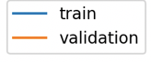
过拟合loss变化曲线
理论上的比较好的loss
理论上的比较好的loss

Slide 28
from keras.models import Sequential
from keras.layers import Dense
from keras.layers import LSTM
from matplotlib import pyplot
from numpy import array
# return training data
def get_train():
seq = [[0.0, 0.1], [0.1, 0.2], [0.2, 0.3], [0.3, 0.4], [0.4, 0.5]]
seq = array(seq)
X, y = seq[:, 0], seq[:, 1]
X = X.reshape((5, 1, 1))
return X, y
# return validation data
def get_val():
seq = [[0.5, 0.6], [0.6, 0.7], [0.7, 0.8], [0.8, 0.9], [0.9, 1.0]]
seq = array(seq)
X, y = seq[:, 0], seq[:, 1]
X = X.reshape((len(X), 1, 1))
return X, y
# define model
model = Sequential()
model.add(LSTM(10, input_shape=(1,1)))
model.add(Dense(1, activation='linear'))
# compile model
model.compile(loss='mse', optimizer='adam')
# fit model
X,y = get_train()
valX, valY = get_val()
history = model.fit(X, y, epochs=1200, validation_data=(valX, valY), shuffle=False)
# plot train and validation loss
pyplot.plot(history.history['loss'][500:])
pyplot.plot(history.history['val_loss'][500:])
pyplot.title('model train vs validation loss')
pyplot.ylabel('loss')
pyplot.xlabel('epoch')
pyplot.legend(['train', 'validation'], loc='upper right')
pyplot.show()

Slide 29
消除过拟合
1. 检测训练数据集和测试数据是否有相对应的特征
增加训练数据的种类, 使得训练数据覆盖所有测试数据的特性
使用数据增强
2. 减小网络复杂度
3. 增加正则化
L1 Regularization
L2 Regularization
4. 增加Drop层
5. 添加Batch Normalizatin
理论上的比较好的loss

Slide 30
References
文本合成: https://noon99jaki.github.io/publication/2017-text-gen.pdf
过拟合/欠拟合: https://machinelearningmastery.com/diagnose-overfitting-underfitting-lstm-models/
Early stopping: https://machinelearningmastery.com/how-to-stop-training-deep-neural-networks-at-the-right-time-using-early-stopping/

Slide 31
Appendix

Slide 32
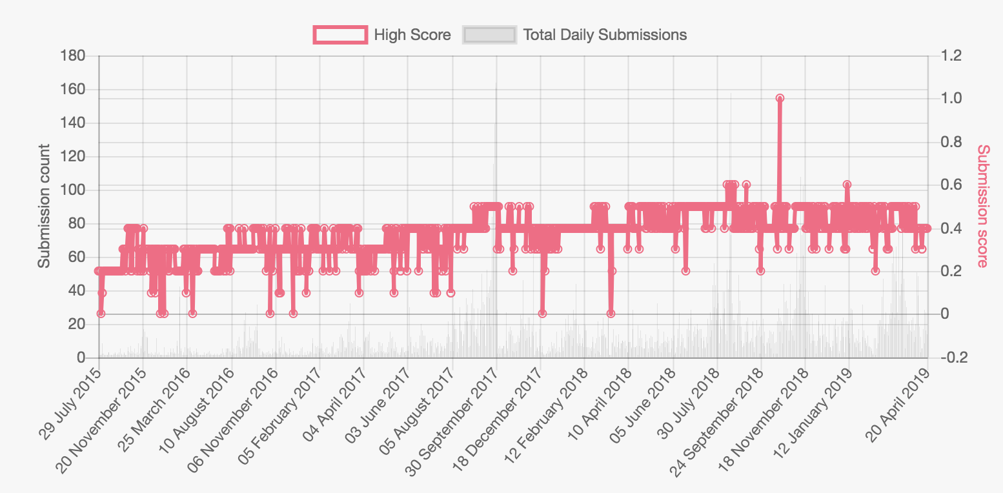
目标分割的效果
https://competitions.codalab.org/competitions/5181

